Slide 1

Eco-Resilient Networks Smart Deployment for the Future
Activity 2: (SCRUM) Check-in # 1
Muhammad Hamza Shahab
Syed Haider Abbas Naqvi
24th February 2025
Researching and Engineering Community Centred Software
Notes:
Brief intro - "Good morning, we're presenting our progress on the Eco-Resilient Networks project."

Slide 2
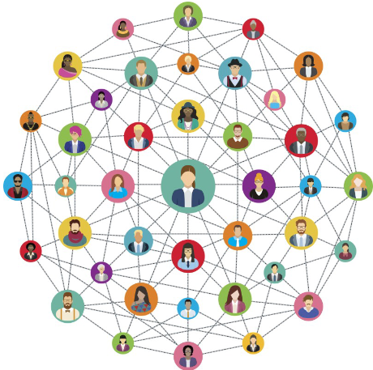

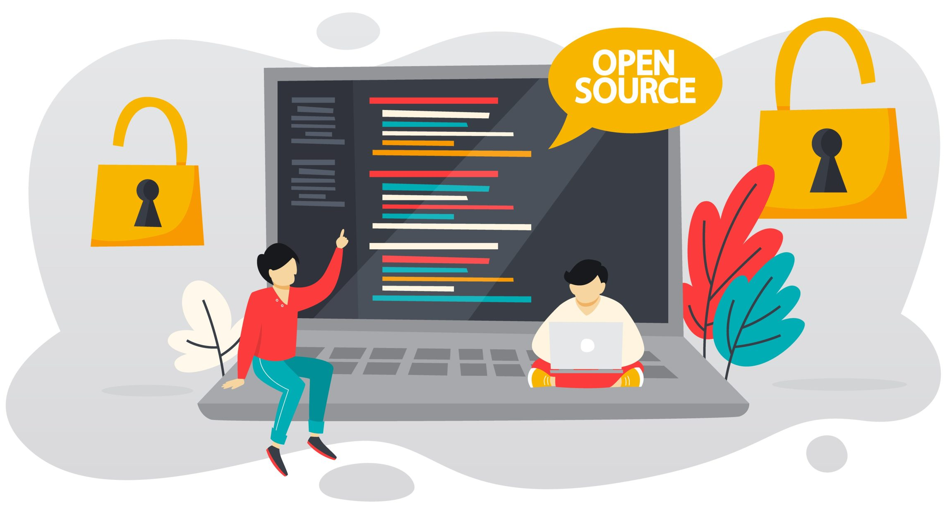
Connection with Course Concepts
Digital Habitats:
Tool for SaskTel engineers' digital workspace.
Community of Practice:
Supporting the practice of network engineering, within the domain of 5G optimization.
Community Orientation:
Supporting projects, providing content, and facilitating access to expertise.
Technology & Community:
Balancing reification (network optimization) and participation (data-driven decisions). Adding sustainability.
Knowledge Management:
Transforming data (network info) into information (metrics) and knowledge (optimal strategies).
Open Source:
Following SECI model and making our simulation framework open source.
Notes:
We identified key gaps in the current technology: a lack of focus on sustainability and limited optimization capabilities.

Slide 3
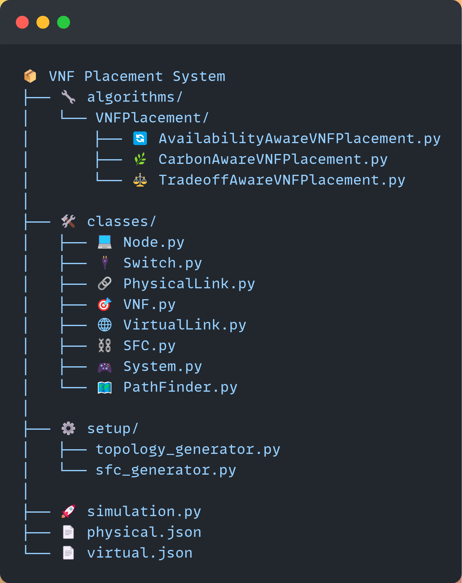
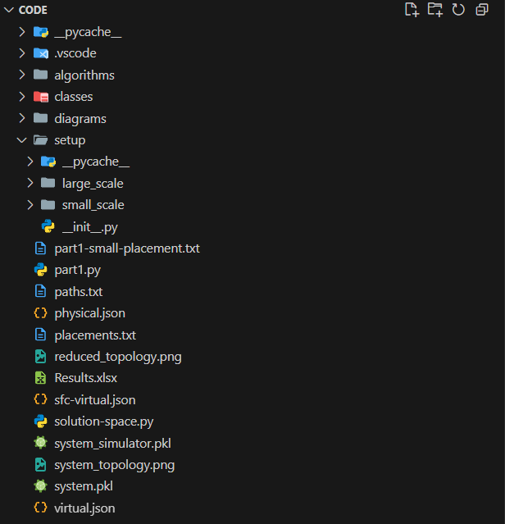
Code Structure Overview
Notes:
Current solutions often overlook the environmental impact. We need a new approach.

Slide 4
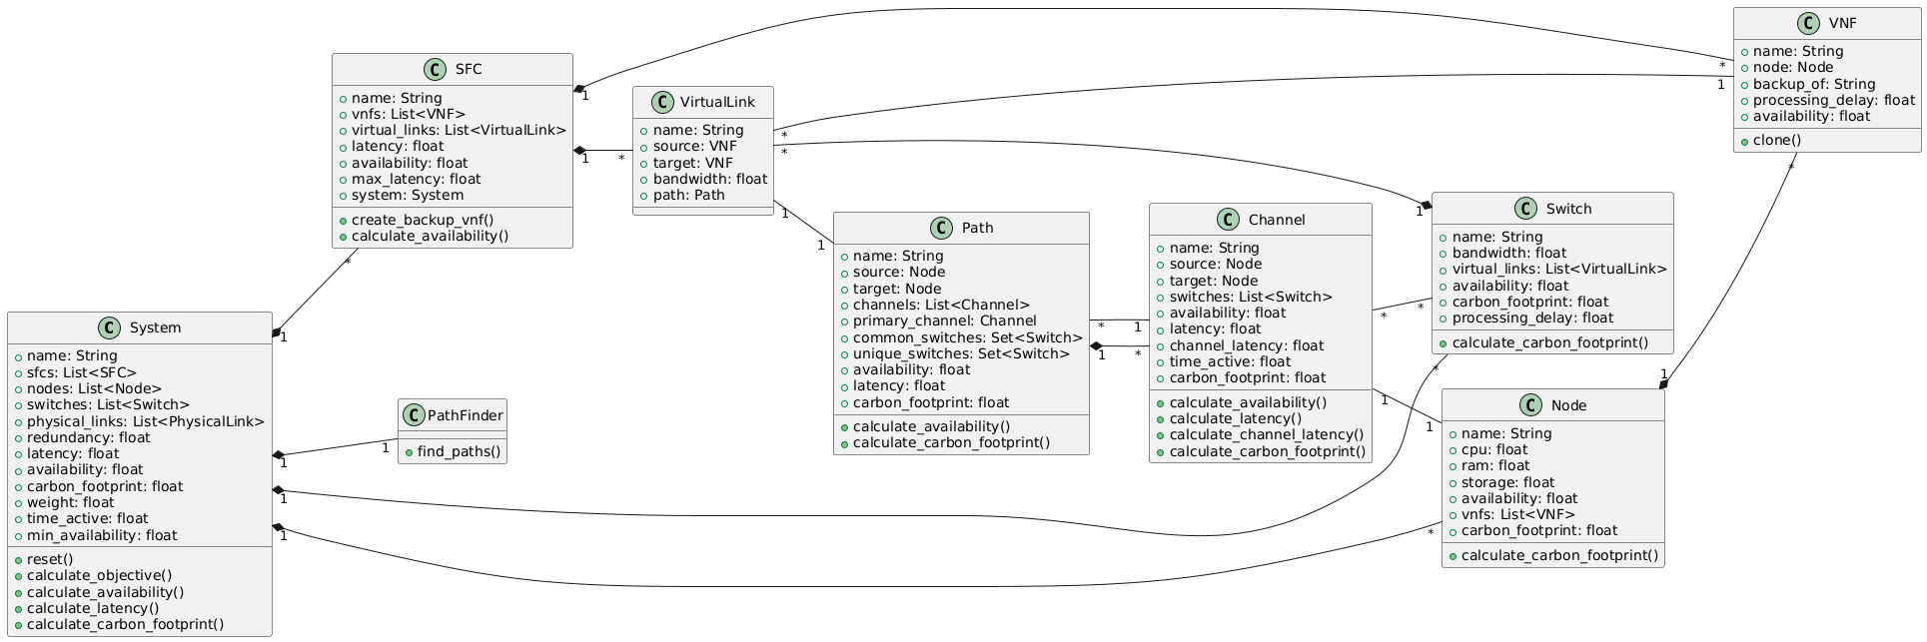
Class Diagram
Notes:
Current solutions often overlook the environmental impact. We need a new approach.

Slide 5
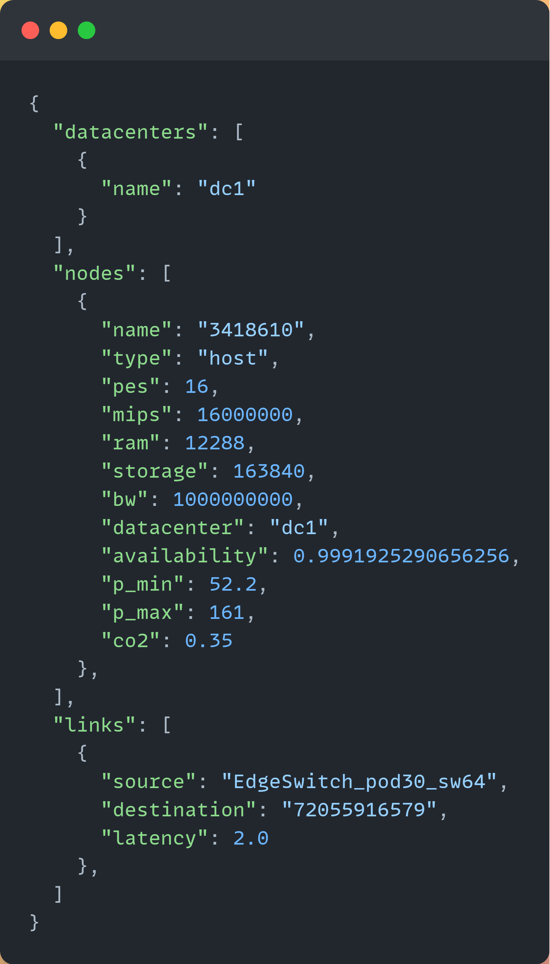
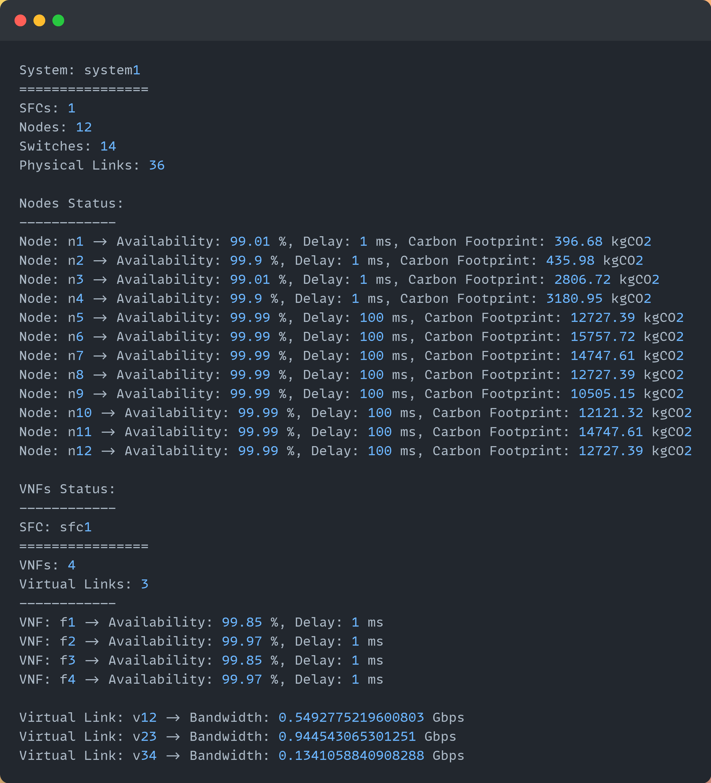
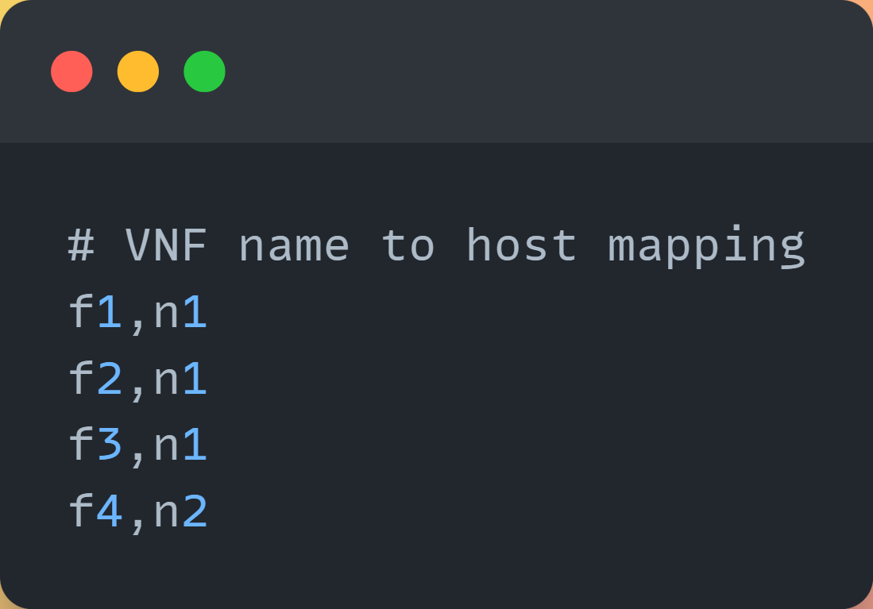
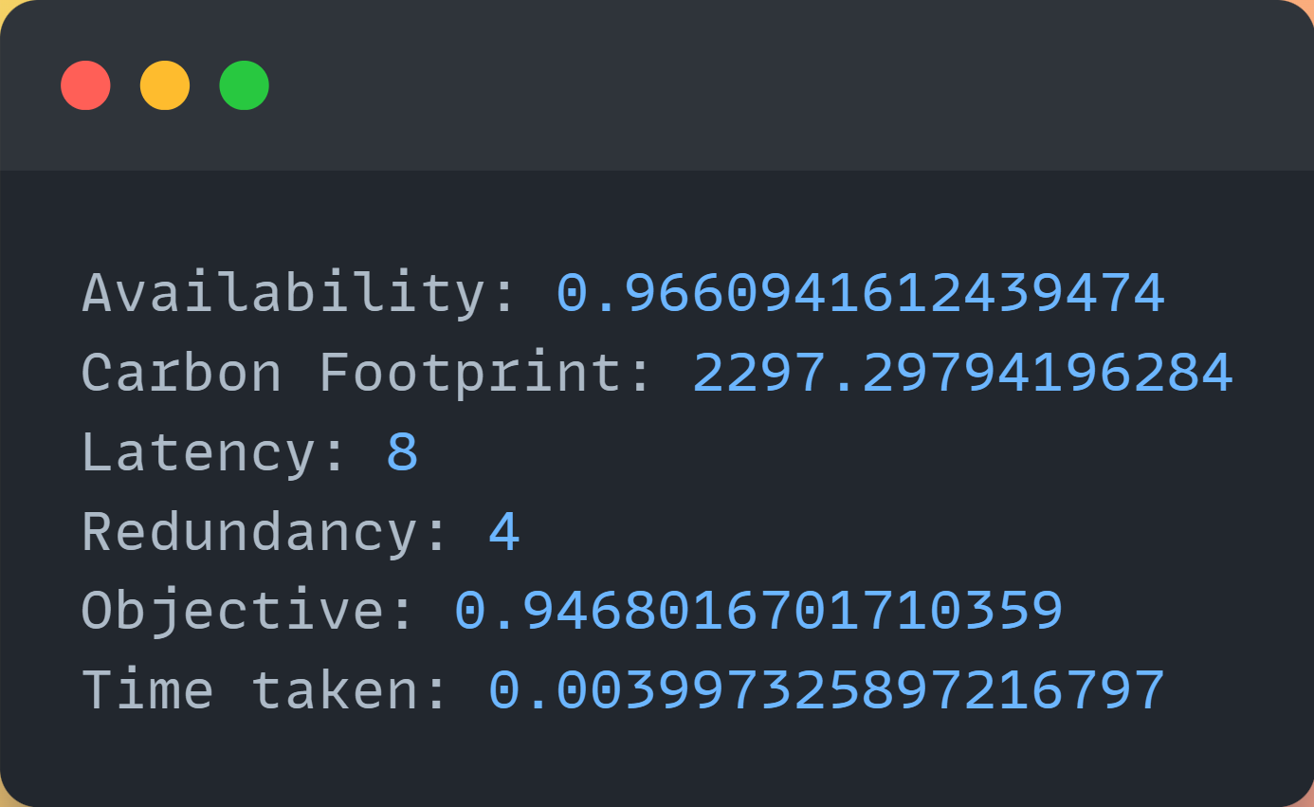
Input Output (I/O) Modules
Placement Info
Metrics Info
Topology Input
System Info
Notes:
Current solutions often overlook the environmental impact. We need a new approach.

Slide 6
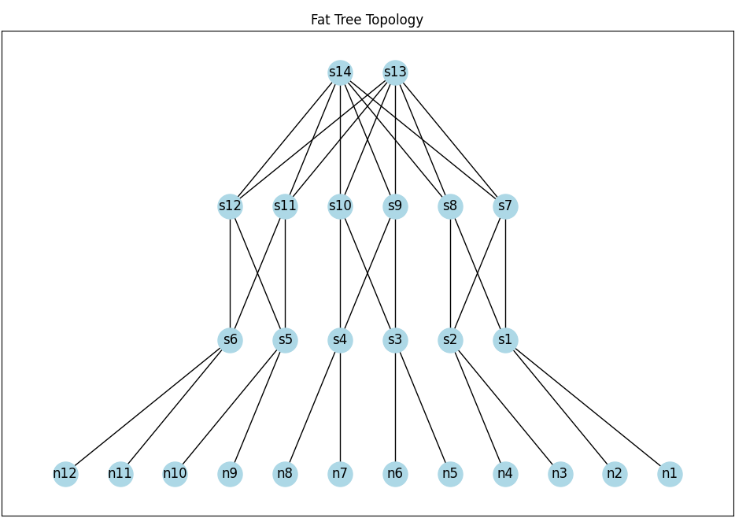
Visualization Module
Notes:
Current solutions often overlook the environmental impact. We need a new approach.

Slide 7
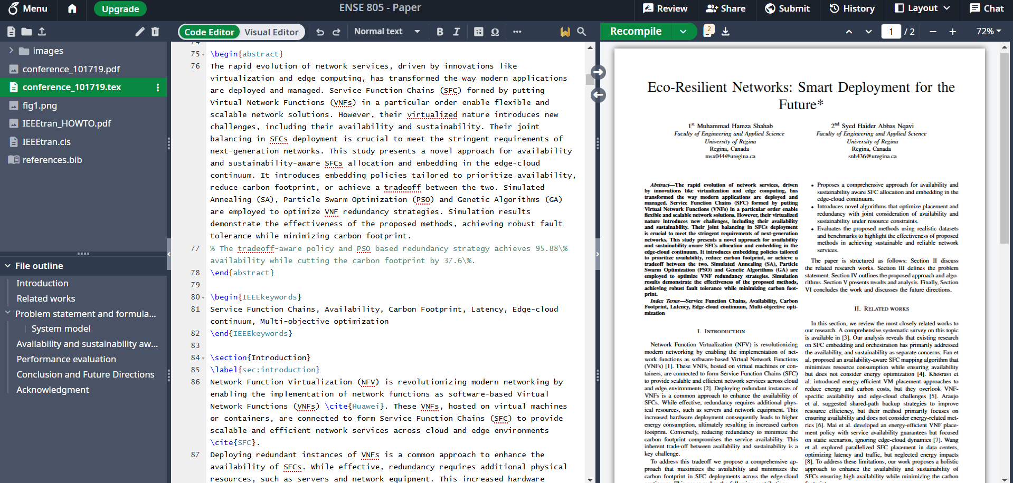
Paper Progress - Snapshot
Notes:
Our project addresses the need for both reliable and sustainable networks. We're focusing on SaskTel as our primary user community.

Slide 8
Paper Writing Progress
Section | Status | Notes
Abstract | ✅ Done | Final metrics to be added
Introduction | ✅ Done | Completed
Related Works | ✅ Done | Completed
Problem Formulation | ⏳In Progress | Expected till next scrum
Methodology | ⏳In Progress | Expected till next scrum
Results & Analysis | ❌ Not Started | Data collection ongoing
Conclusion | ❌ Not Started | Will finalize after results

Slide 9
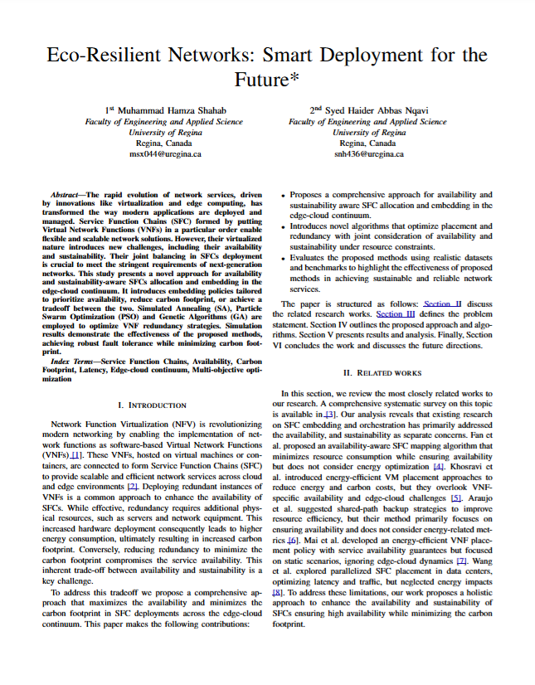
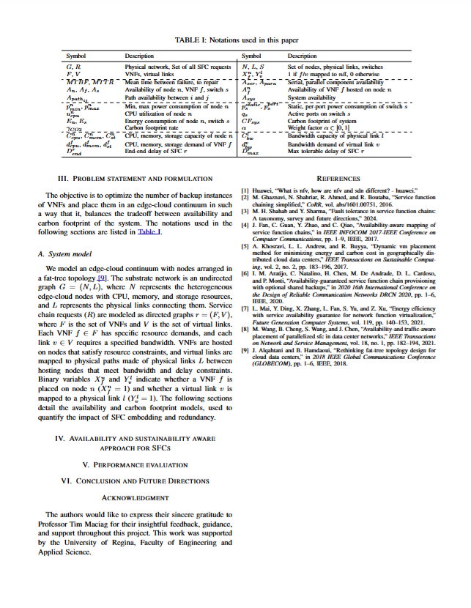
Notes:
Our project addresses the need for both reliable and sustainable networks. We're focusing on SaskTel as our primary user community.

Slide 10

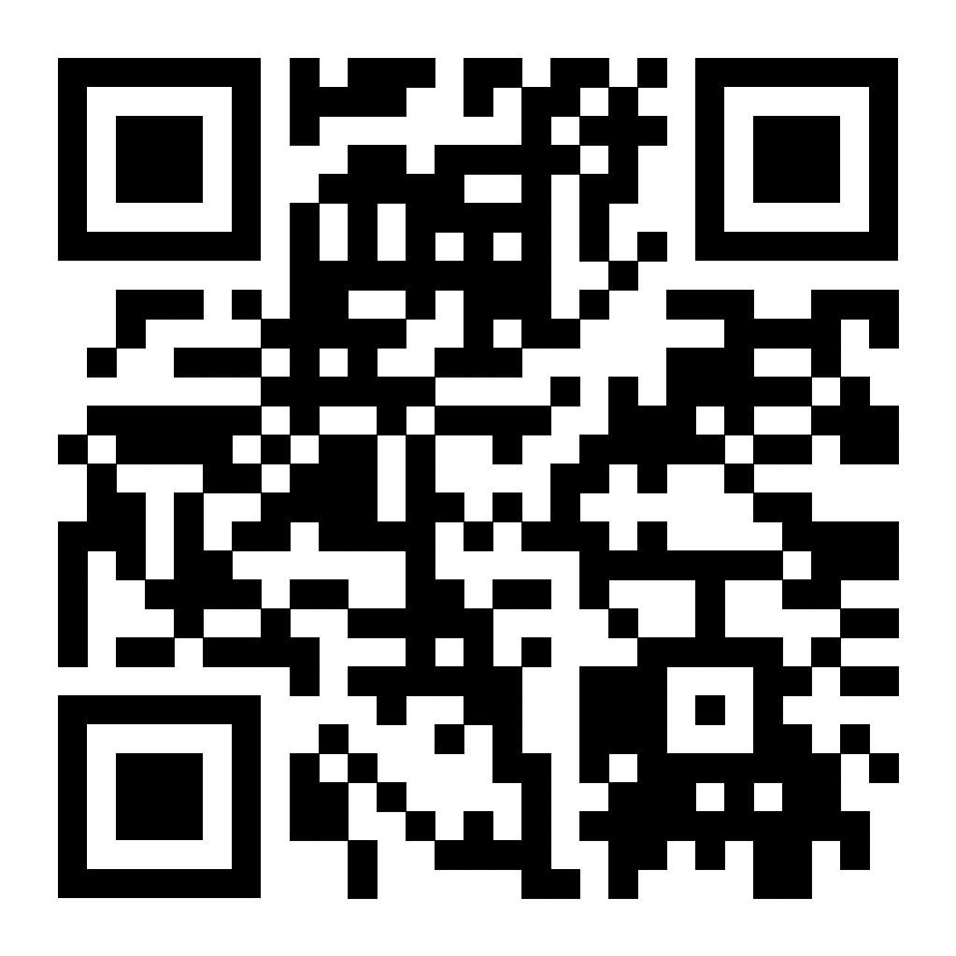
Thank You - Let’s Build Sustainable Networks!
Project Link: https://github.com/hamzashahab1610/ENSE-805-Project-Eco-Resilient-Networks.git
Contact:
Email: msx044@uregina.ca
LinkedIn: https://www.linkedin.com/in/hamzashahab1610/
GitHub: https://github.com/hamzashahab1610

